Slide 1

ECE 441 Lab 4:
Cloud Database and Mobile Device
Presented by Mikhail Gromov
Instructor: Dr. Jafar Saniie
TAs: Xinrui Yu, Tianyang Fang, Mikhail Gromov
ECASP (Embedded Computing and Signal Processing) Research Laboratory (ecasp.ece.iit.edu)
Department of Electrical and Computer Engineering
Illinois Institute of Technology

Slide 2
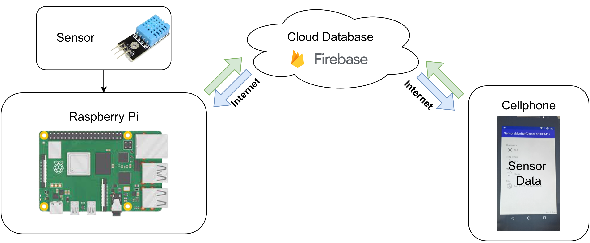
System Diagram

Slide 3
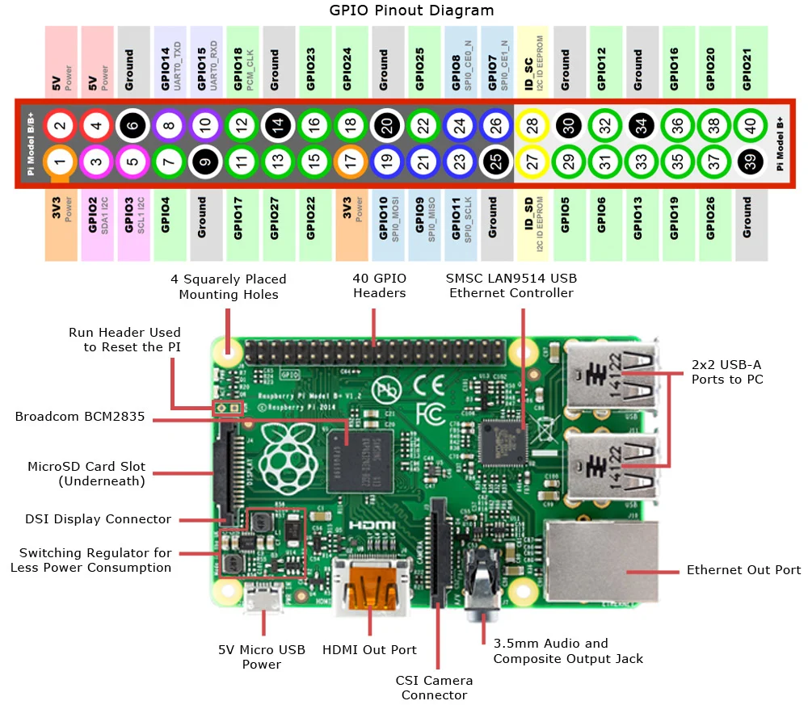
Raspberry Pi 3 Overview
Raspberry Pi is a microcontroller
Linux-based Raspbian OS
Clock rate of 1.2GHz, with four cores
1GB of RAM and variable microSD
Similar to regular computers
Raspberry Pi has 40 GPIO pins

Slide 4
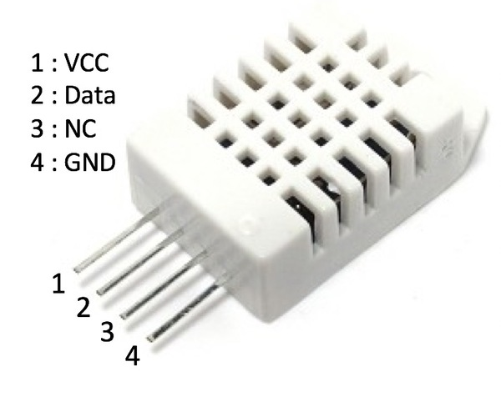
DHT22
Measures temperature and humidity
Temperature accurate up to 0.5C
Humidity accurate up to 1%
Temperature range from -40C to 80C
Humidity range is 0 to 100%
Measures every 2 seconds
Data pin used for communication with library
Sensor only outputs values when requested

Slide 5
Firebase Introduction Video Links
Firebase Introduction: https://firebase.google.com/docs/database
Beginner’s Guide: https://www.youtube.com/watch?v=9kRgVxULbag

Slide 6
Firebase Real-time Database
Uses JSON for communication
Can synchronize data between multiple devices
Data stored locally when offline
Supports many SDKs
Built-in cybersecurity features
Remote configuration
Firebase cloud messaging
Analytics

Slide 7
Android
Operating system used on many phones
Also present in other smart devices (watches, TVs, cars, etc.)
Developed and maintained by google
Based on the Linux Kernel, but does not use GNU
Open source version is Android Open Source Project
Many manufacturers modify it, but maintain compatibility

Slide 8
Android SDK Video Links
Introduction Video: https://developer.android.com/guide
Quick Android SDK Guide Video: https://www.youtube.com/watch?v=kMI2jy-WlGM
15 Hour Course Video: https://www.youtube.com/watch?v=fis26HvvDIIhttps://www.youtube.com/watch?v=RcSHAkpwXAQ

Slide 9
Android SDK
Used to develop applications for Android phones
Provides APIs to interact with phone hardware
Contains a Built-in Android emulator
Provides Android Debug Bridge(adb) command
  Allows app installation and debugging on physical phone
  Provides a system trace
Uses the Java programming language
NDK available for apps that require C/C++ for performance

Slide 10
Firebase Setup (Demo)

Slide 11
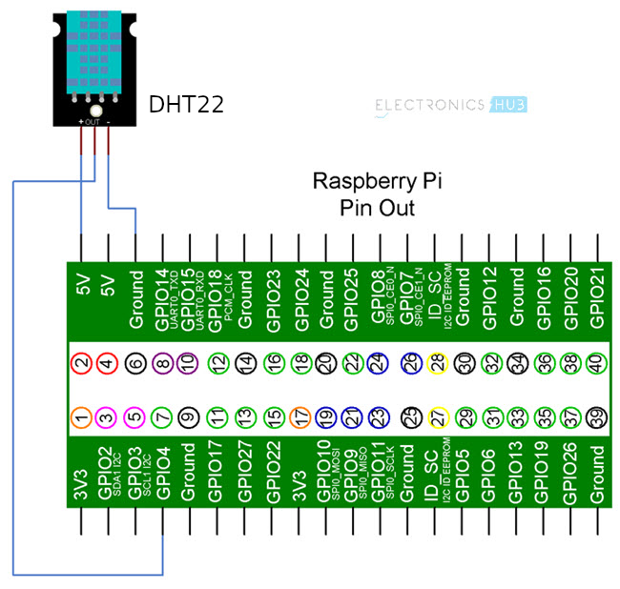
Raspberry Pi Wiring

Slide 12
Raspberry Pi Code Setup (Demo)

Slide 13
Application Side Firebase Setup (Demo)

Slide 14
Application Running on Emulator (Demo)

Slide 15
Application Running on Phone (Demo)

Slide 16
Conclusion
Smart phones are often used to interact with people in smart systems
Android SDK can be used to develop phone applications
Firebase can manage and display data in a user-friendly manner
There are many other cloud solutions
Consider multiple different application structures
  Raspberry Pi ↔ Cloud ↔ Phone
  Raspberry Pi ↔ Phone ↔ Cloud
  Phone ↔ Raspberry Pi ↔ Cloud

